Slide 1


GREEN LOGISTICS BY A COMPARATIVE STUDY TO MINIMIZING CO2 EMISSIONS
BY USING ACO, GA & HYBRID ACO-DRL
Presented by Sushmita Gupta x22219455@student.ncirl.ie

Slide 2

INTRODUCTION
1
The logistics sector is a significant contributor to CO2 emissions, accounting for 28% of greenhouse gas emissions in 2022. Optimizing logistics routes is essential to minimizing these environmental impacts while also enhancing operational efficiency.
This study explores the effectiveness of Ant Colony Optimization (ACO), Genetic Algorithm (GA), and a Hybrid Ant Colony Optimization-Deep Reinforcement Learning (ACO-DRL) model in optimizing logistics routes to reduce CO2 emissions and fuel consumption.
Research Question:
"How effective is Ant Colony Optimization (ACO) compared to Genetic Algorithms (GA) & Hybrid Models such as ACO-DRL in providing more efficient solutions for improving logistics routes to reduce CO2 emissions & fuel consumption while maintaining logistics efficiency?"
NATIONAL COLLEGE OF IRELAND | 2024

Slide 3

2
RELATED WORK
Title | Authors | Key Focus | Relevance to the Research
Enhanced Vehicle Routing Problem with Capacity Constraints Using K means Clustering and Ant Colony Optimization | Şehitoğlu and Aghayeva (2023) | Integration of K-means clustering with ACO for solving the Capacity Vehicle Routing Problem (CVRP). | By clustering and applying ACO, GA & ACO-DRL the logistics efficiency can be improved and reduce co2 emission
Optimization of Logistics Networks Using Hybrid DRL Approaches | Xu et al. (2024) | Hybrid model integrating DRL with clustering techniques to optimize taxi dispatching. | By integration of ACO &DRL the end result can be more refined.
Ant Colony Optimization for Dynamic Logistics Routing : A Comparative Study | Shojaie and Bariran (2021) | Comparative analysis of ACO and Extended Dijkstra’s Algorithm for dynamic logistics routing. | ACO is proven to be the optimal solution and is supported by this paper
NATIONAL COLLEGE OF IRELAND | 2024

Slide 4

METHODOLOGY
3
STEP | DESCRIPTION
Data Collection | - Dataset: 42,297 entries from UPS facilities. - Removed outliers (e.g., Hawaii & Alaska). - Filtered key logistics points (Authorized Shipping Outlet, UPS Drop Box). - Proportional stratified sampling created a subset of 12,000 entries.
Preprocessing | - Identified and removed outliers using Interquartile Range (IQR). - Ensured clean and relevant data for clustering and optimization.
Clustering Approach | - K-means Clustering: - Optimal number of clusters (K=4) determined using the Elbow Method. - Clustering based on geographical coordinates (Latitude, Longitude).
Optimization Algorithms | - Applied ACO, GA, & Hybrid ACO-DRL on clustered data. - Focused on minimizing travel distance and reducing CO2 emissions.

Slide 5
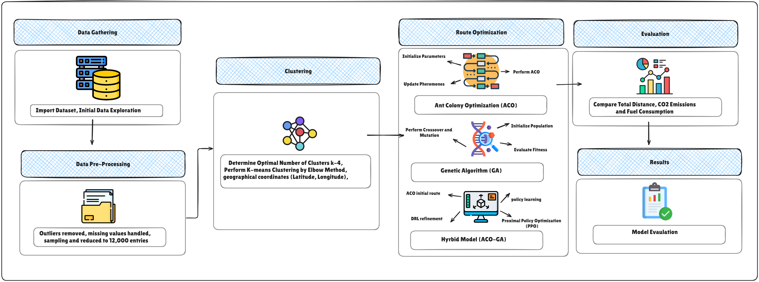
METHOD FLOW
4
NATIONAL COLLEGE OF IRELAND | 2024

Slide 6
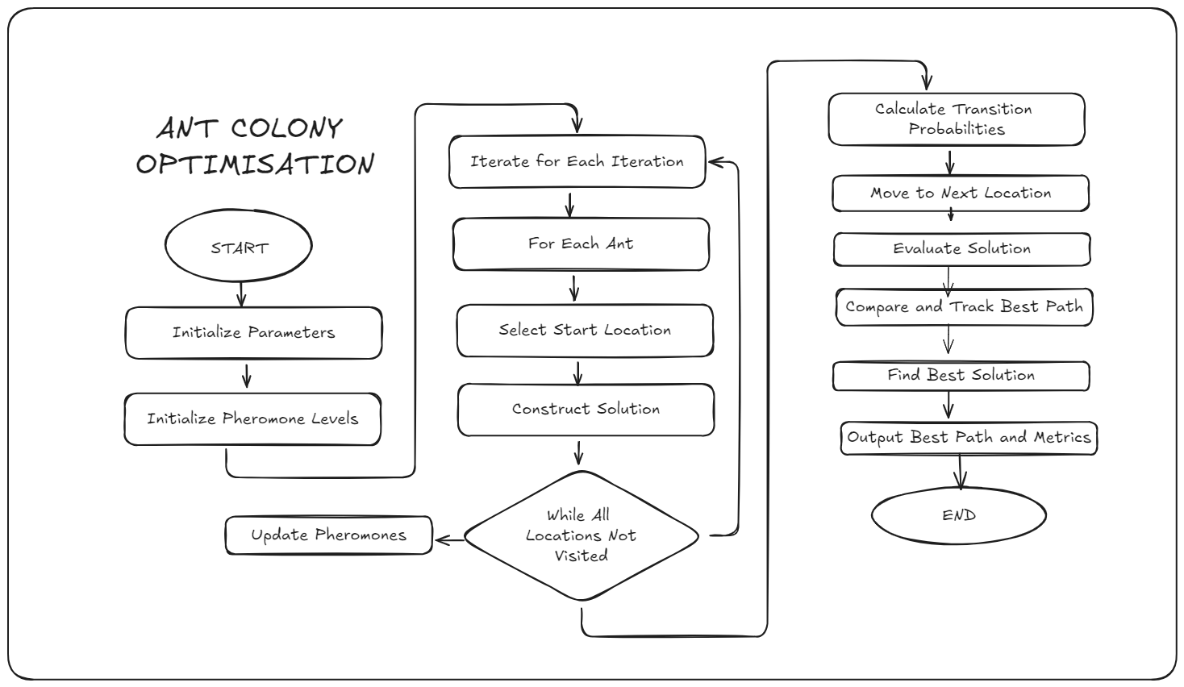

ACO
5
NATIONAL COLLEGE OF IRELAND | 2024

Slide 7
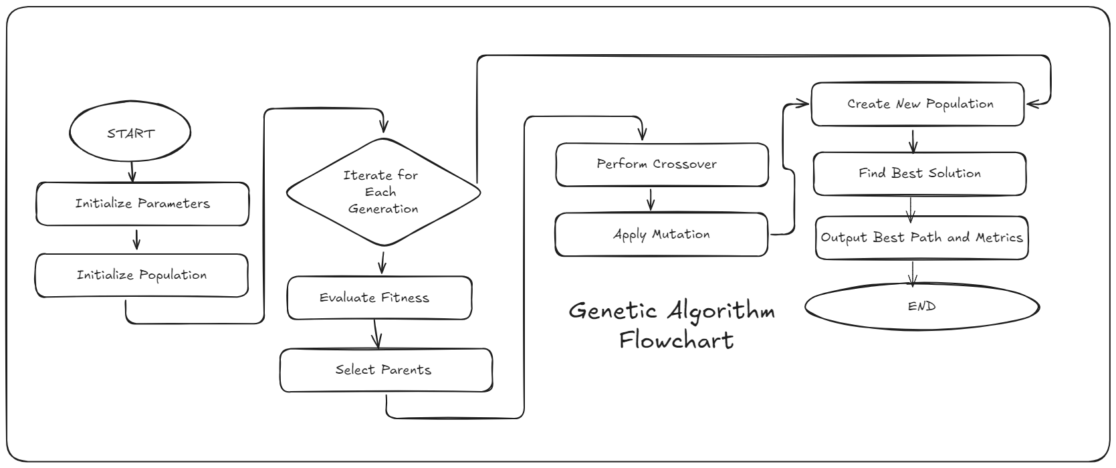

GA
6
NATIONAL COLLEGE OF IRELAND | 2024

Slide 8
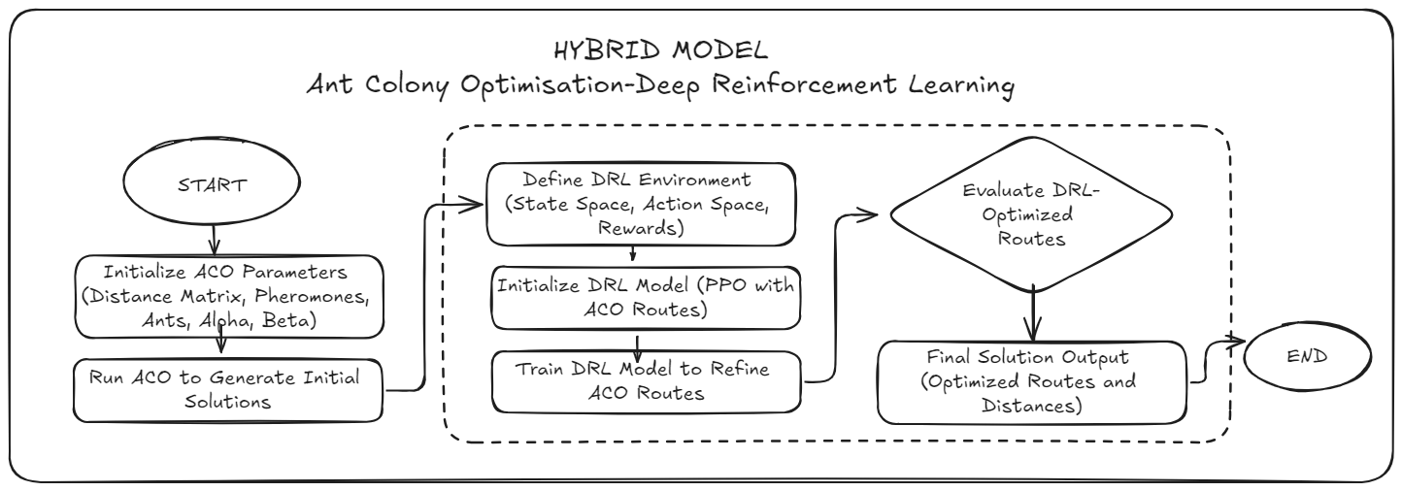

ACO-DRL
7
NATIONAL COLLEGE OF IRELAND | 2024

Slide 9

8
LIVE
DEMONSTRATION
NATIONAL COLLEGE OF IRELAND | 2024

Slide 10

9
MODEL EVAULATION
Model | Total CO2 Emissions (kg) | Improvement Over GA (%) | Improvement Over ACO (%) | Best Performing Model
ACO | 532.20 | 97.59% | - | ACO (3 clusters)
GA | 22077.36 | - | - | -
ACO-DRL | 739.81 | 96.65% | -39.01% | ACO-DRL (1 cluster)

Slide 11

10
CONCLUSION
ACO gives the best results, while evaluating the results of the ACO model, the emission of CO2 is considerably lower than with GA, equal to 97. 59% improvement
GA: The GA model has the highest CO2 emissions hence making it the least efficient model for this problem.
ACO-DRL: ACO-DRL improves the performance of the GA with 96.65% but not ACO, although in Cluster 0 it was the best model.
In terms of the overall reduction of CO2 emissions, ACO is the best model giving the most consistent decrease in the emissions in the majority of clusters. ACO-DRL has possibility in certain conditions.

Slide 12
11
FUTURE WORK
Dynamic Parameter
Tuning
Integration of Real-Time
Environmental Data
Exploration of Additional Hybrid Techniques
Refinement of the DRL Model

Slide 13
THANK YOU
Sushmita Ghanshyam Gupta
x22219455

